Slide 1
LearnZilla
Shyam Patel (AU1741030)
Jay Shah (AU1741084)
Shantanu Sheth (AU1741088)

Slide 2
Project Brief
The proposed product here is a web application which lets you learn for the competitive exams with interactive videos and prepare for the exams through different exams.
The software will be having a Login/Signup functionality followed by browsing through two different courses GRE and IELTS.
The GRE section comprises of verbal and quantitative modules. Some practice tests and vocabulary section for practice.
The IELTS section comprises of Listening, Reading, Writing and Speaking modules. Some practice tests and vocabulary section for practice.
The proposed product is beneficial for students and also for those who want to pursue higher education in foreign countries.

Slide 3
Implementation
Central Server used as Scalable Express API Gateway
All microservices are isolated in a container and all of them together are exposed to external web through API Gateway
Frontend is hosted on Client side Architecture
All the APIs can communicate to each other through REST calls via API Gateway
Concept of JWTs and Refresh tokens are used for Authentication
Clean Architecture for forums microservice has been implemented

Slide 4
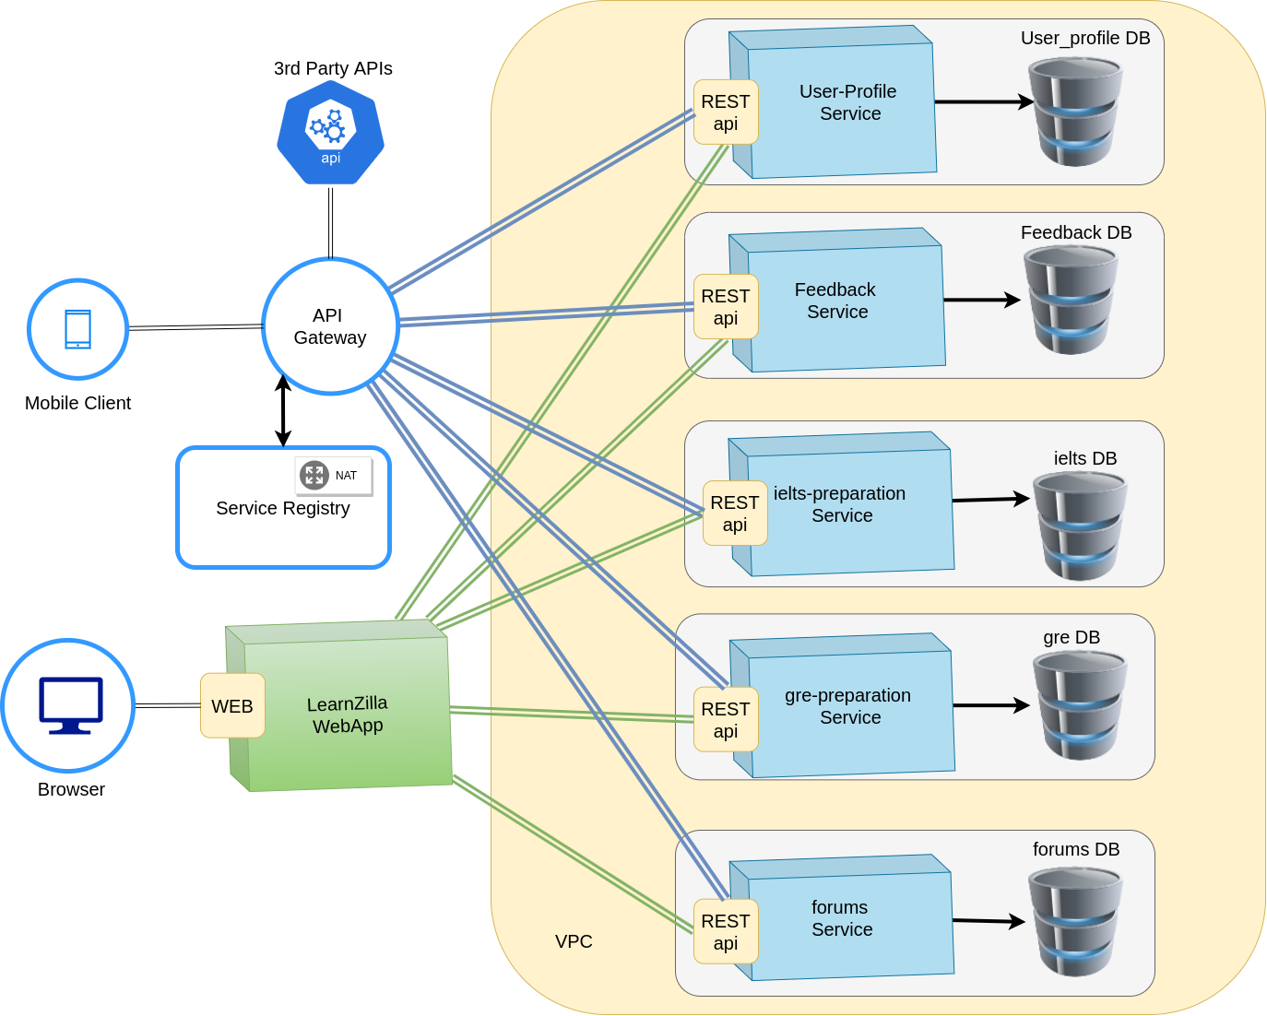
System Architecture

Slide 5
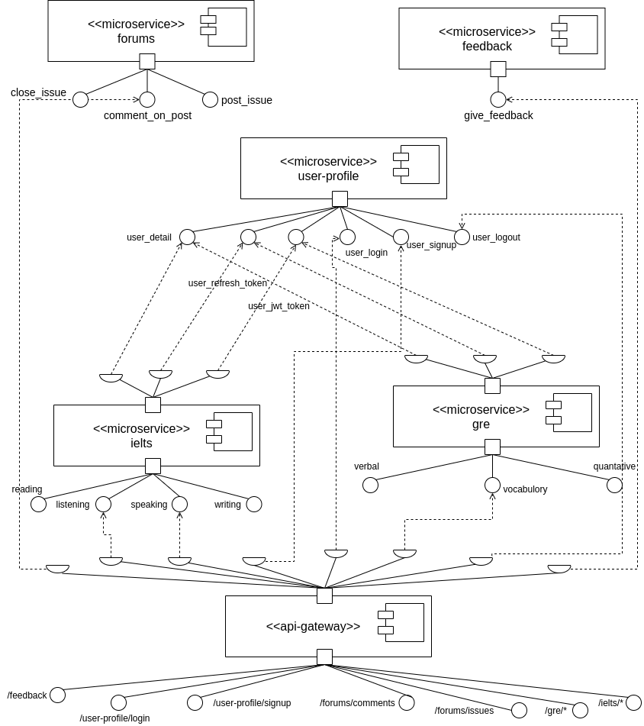
Class Diagram

Slide 6
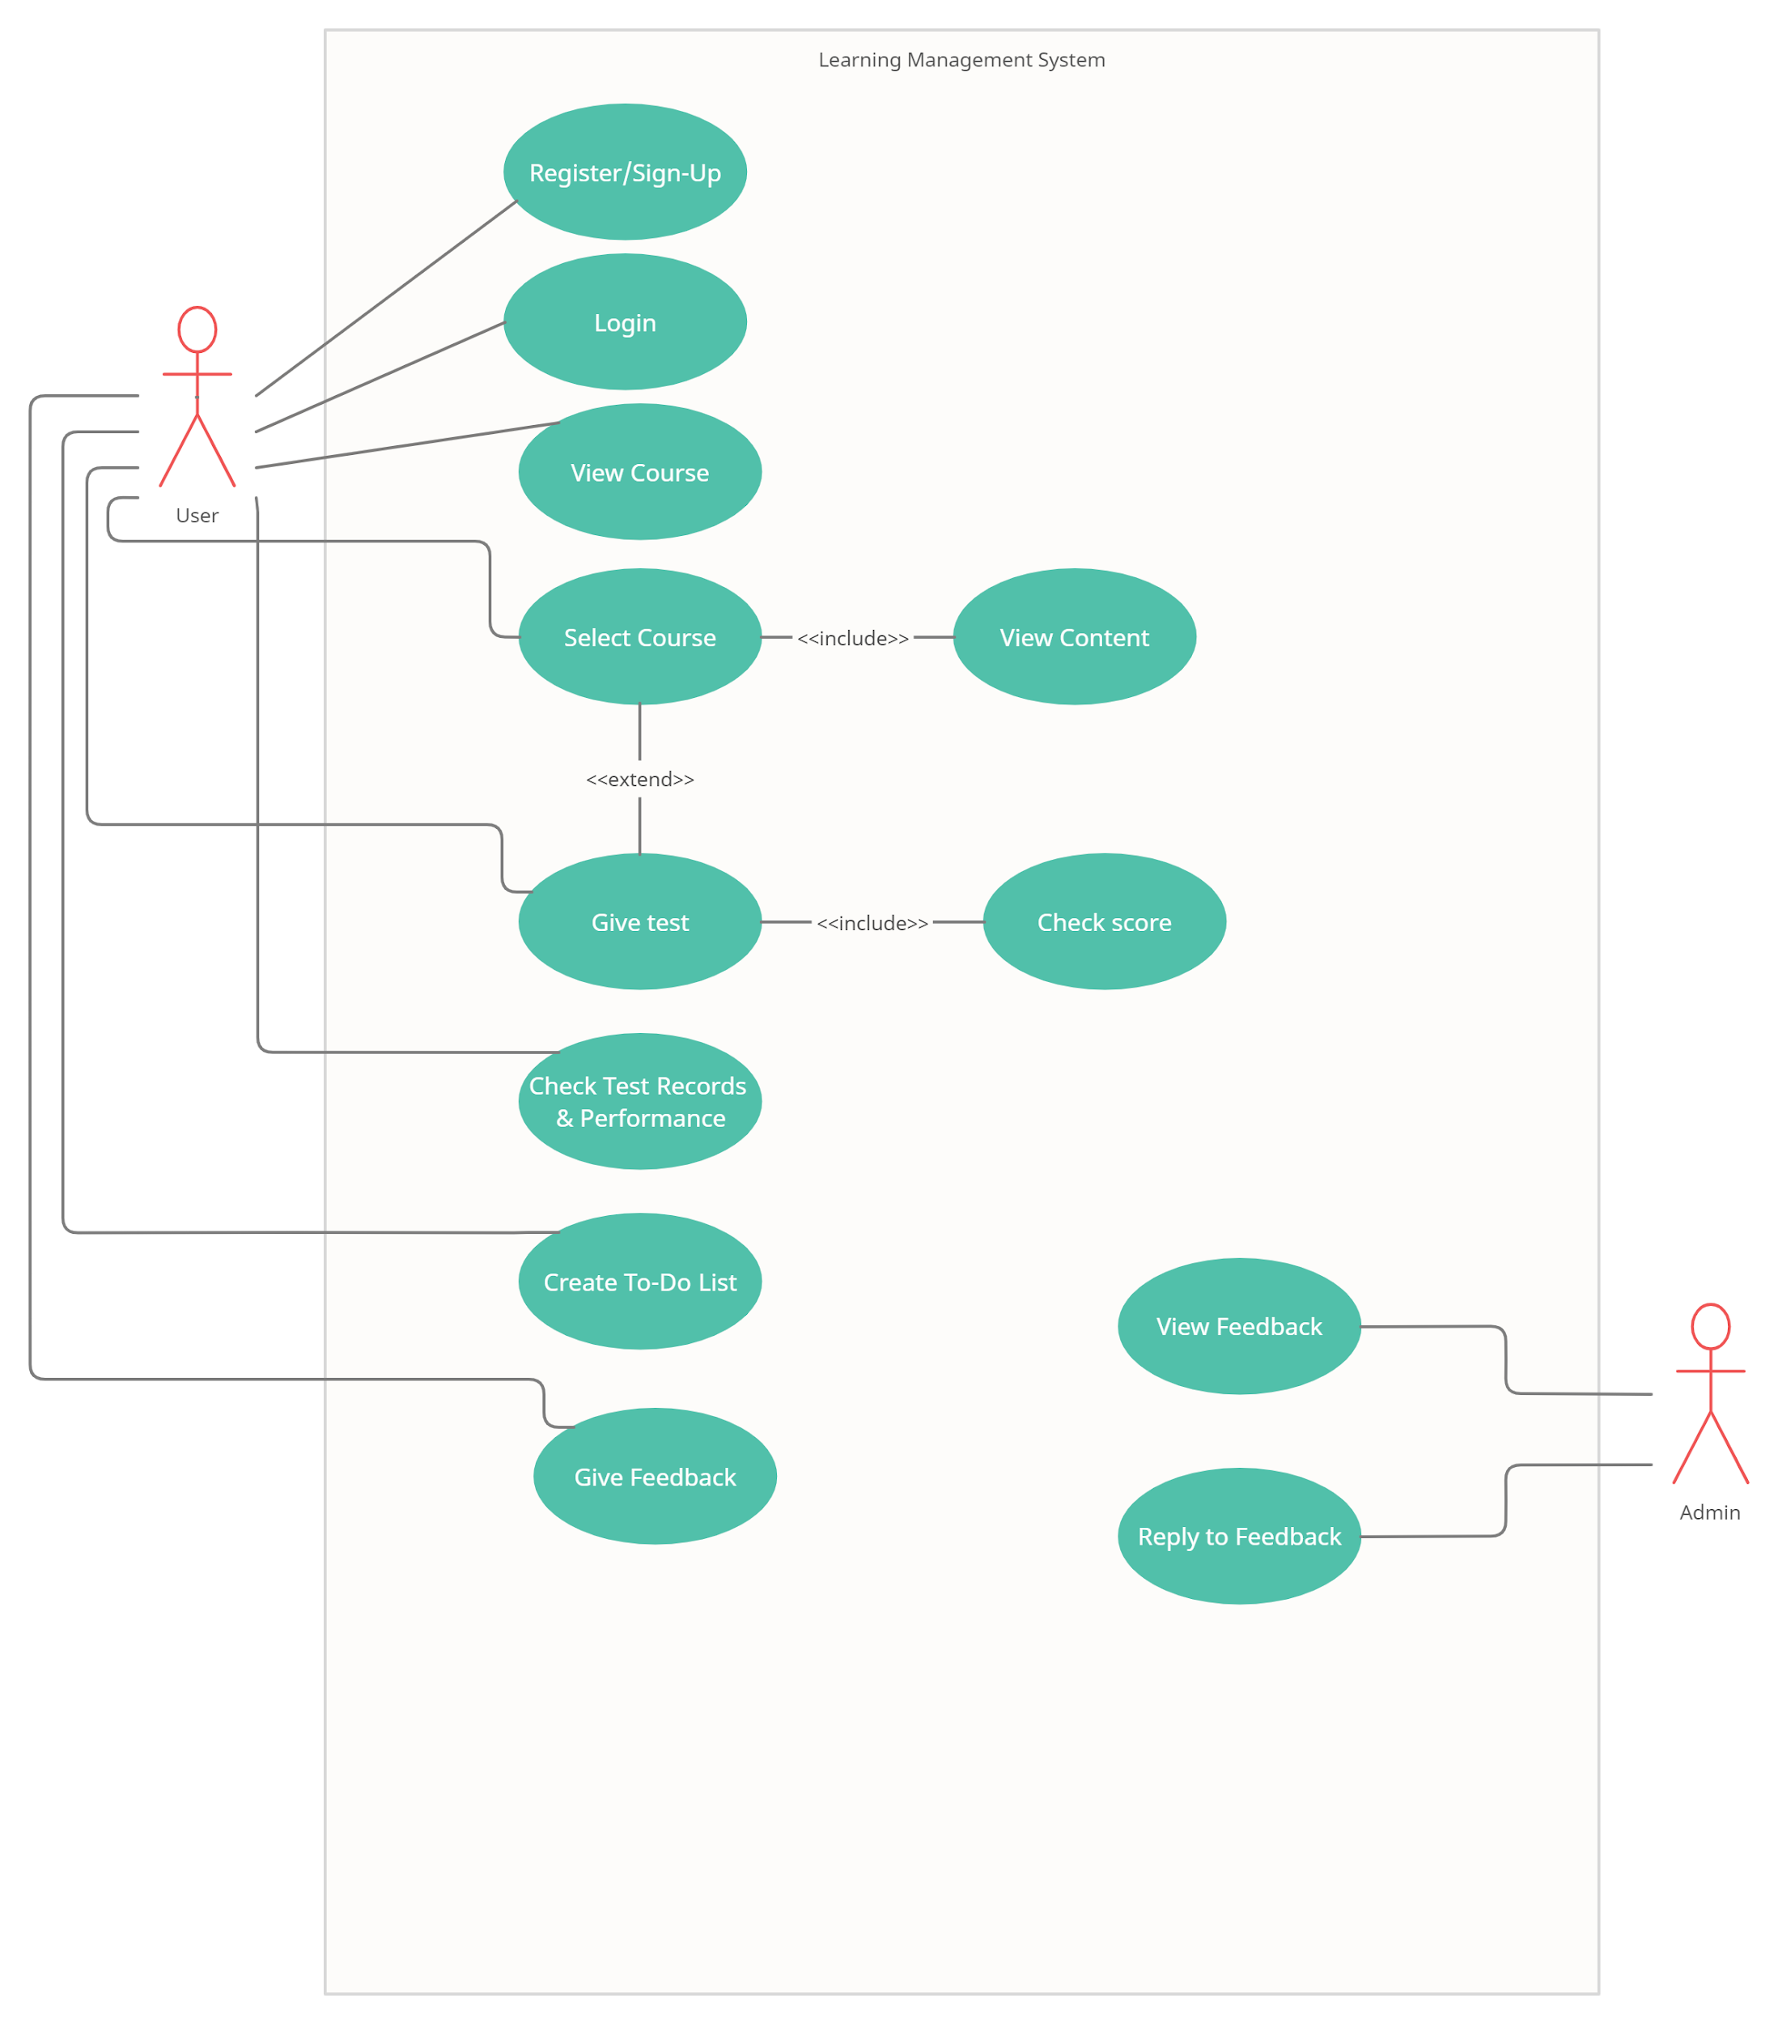
Use Case Diagram

Slide 7
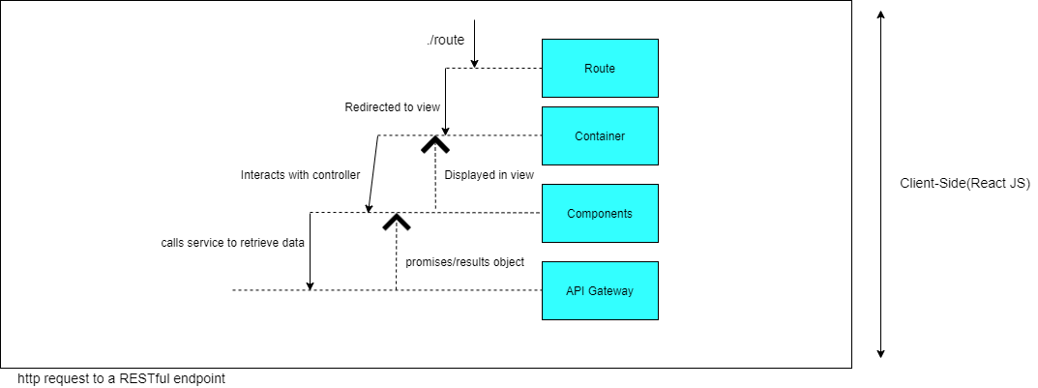
FrontEnd Architecture

Slide 8
List of Microservices
IELTS Preparation Service
GRE Preparation Service
Feedback Service
User Profile Service
Forums Service

Slide 9
Tools & Technology Used for Development
Visual Studio Code (latest version) for coding
Github for Code Collaboration and version control
Github Projects for task and milestone completion
MongoDB Atlas for Database Collaboration
Node & Express for Backend
React for Frontend
Express for API Gateway
Figma for Prototyping

Slide 10
Future Work
For Future works we can make a mobile App for the same and also implement other aspects of Learning Management.
Hosting online classes, storage options for University and schools, Interactive web app to make learning fun for primary and secondary school students, implementing a hobbies based module that can teach you your favourite hobby for example chess, or correctly exercising or learning how to cook etc.

Slide 11
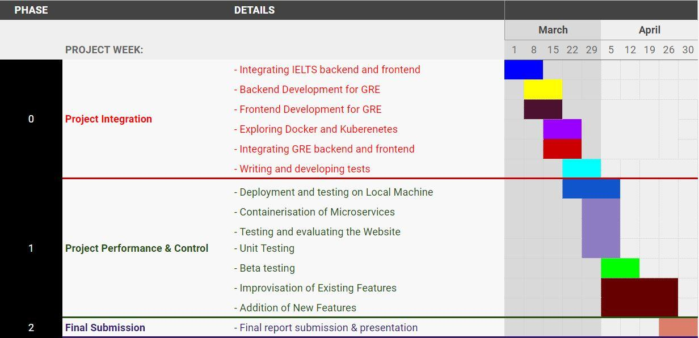
Timeline

Slide 12
References
Virtualization. (2012). Reliability and Availability of Cloud Computing, 16–28. doi: 10.1002/9781118393994.ch2
A Practical Guide to Deploying Cloud-Based Video Services. (n.d.). Retrieved from https://pages.awscloud.com/GLOBAL_IND_practical_guide_whitepaper_2019.html
“ReactJS Documentation.” React, https://reactjs.org/docs/getting-started.html Accessed 28 Feb. 2021.
Node. Js. “Documentation.” Node.Js, 2015, https://nodejs.org/en/docs
Alshuqayran, N., Ali, N., Evans, R.: A systematic mapping study in microservice architecture. In: Service-Oriented Computing and Applications (SOCA), 2016 IEEE 9th International Conference on. pp. 44–51. IEEE (2016)
Mario Villamizar, Oscar Garces, Harold Castro, Mauricio Verano, ´ Lorena Salamanca, Rubby Casallas, and Santiago Gil. Evaluating the monolithic and the microservice architecture pattern to deploy web applications in the cloud. In Computing Col
Matthias Vianden, Horst Lichter, and Andreas Steffens. Experience on a microservice-based reference architecture for measurement systems. In 2014 21st Asia-Pacific Software Engineering Conference, volume 1, pages 183–190. IEEE, 2014.
Sudhir Tonse. Microservices at netflix - challenges of scale. http://www. slideshare.net/stonse/microservices-at-netflix, August 2014.

